Slide 1
Validating nuclear data for lead with
shielding benchmarks
WU Haicheng
China Nuclear Data Center(CNDC) China Institute of Atomic Energy(CIAE) P.O.Box 275-41,Beijing 102413, P.R.China
E-Mail: haicheng@ciae.ac.cn

Slide 2
OUTLINE
Background
Benchmark and calculation
Results of the JAERI/FNS slab
Results of the IPPE Pb sphere
Discussion and Summary

Slide 3
1. Background
Lead is one kind of coolant material in fast reactor. It also can served as shielding material.
The nuclear reaction data for Pb are both important in criticality and shielding transport calculations.
Criticality benchmark testing of CENDL-3.2 show both positive and negative k_{eff} bias in lead reflected criticality benchmarks HMF057.
Pb is one of top 10 materials that contributed to the total criticality k² most.
Shielding benchmark can show and even amplify the defects in nuclear data only related to the sample tested.
To validate the reaction data for lead, the evaluated data from major libraries were tested with the JAERI/FNS and ALARM-Cf-Pb experiments.

Slide 4
2. Simulation and analysis method
Nuclear data preparation
Njoy99.396 + local patch c10.
CENDL-3.2, ENDF/B-VIII.0, JEFF-3.3, JENDL-4.0, BROND-3.1.
Transport calculation
MCNP5 + 10⁷ history
No variance reduction technology was applied in calculation.
Sensitivity of shielding benchmark
Decay of the neutron flux in the media follows the law of indices.
Neutron flux
Sensitivity of
neutron flux

Slide 5
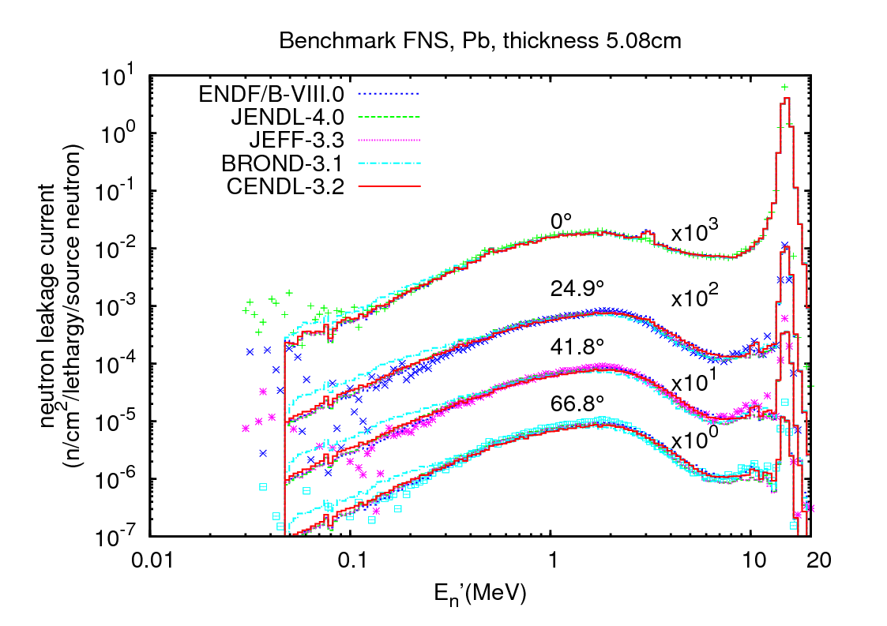
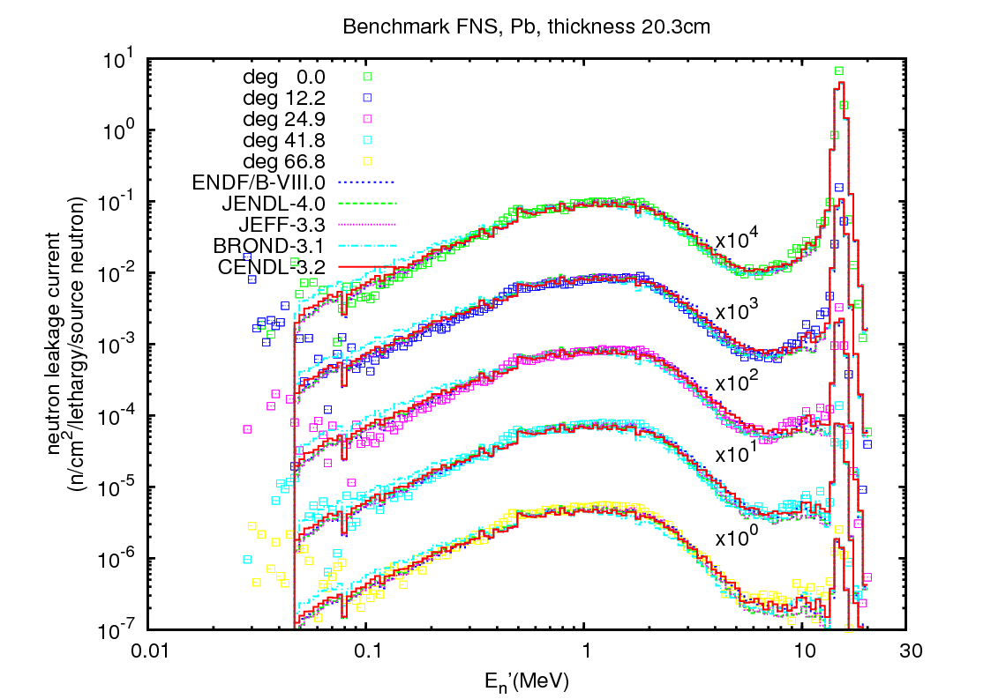
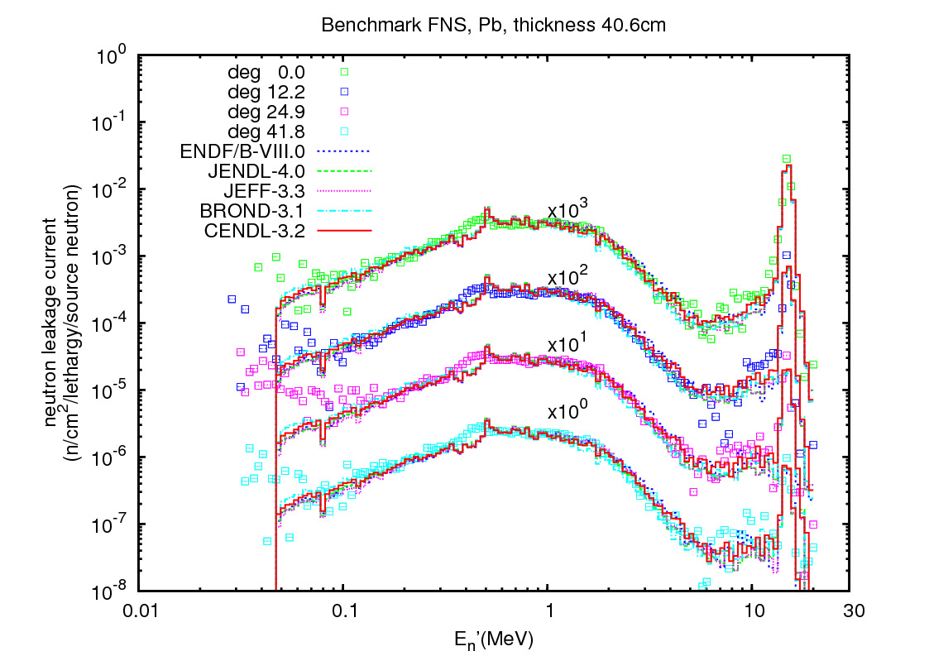
3. Result of the JAERI/FNS slab
Similar results based on different evaluation library.
Under prediction of neutron fluxes were found around 4MeV and from 8-14MeV.
Bias below 0.1MeV are ignored in this work.
5cm
20cm
40cm

Slide 6
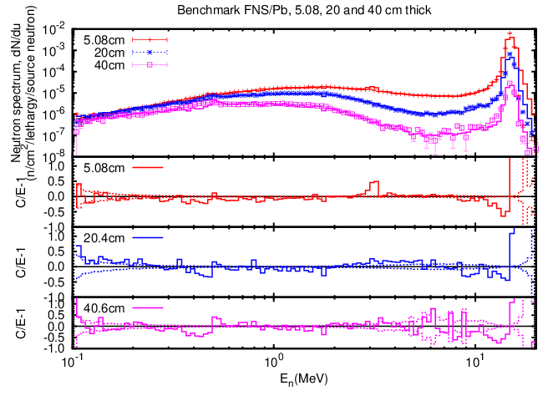
3. Result of the JAERI/FNS slab
Bias related to thickness
0.366-0.494MeV and 8.13~14.8MeV are corresponding to (n,el) and (n,inl) reaction separately.
CENDL-3.2

Slide 7
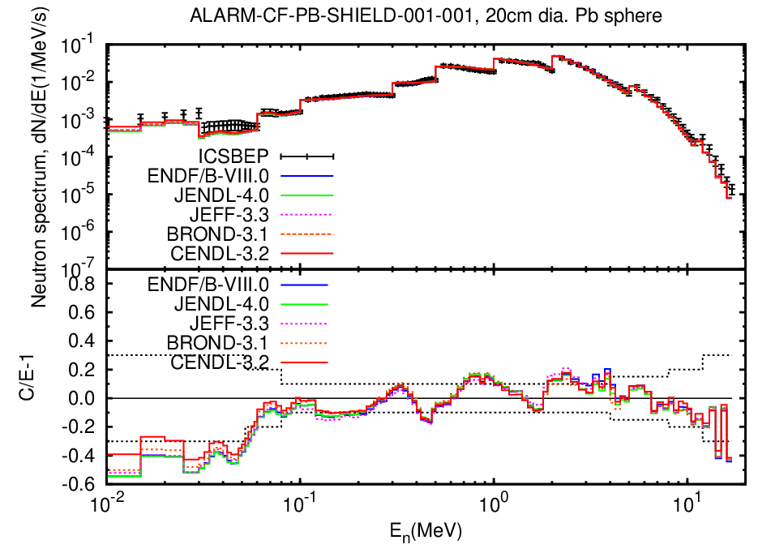
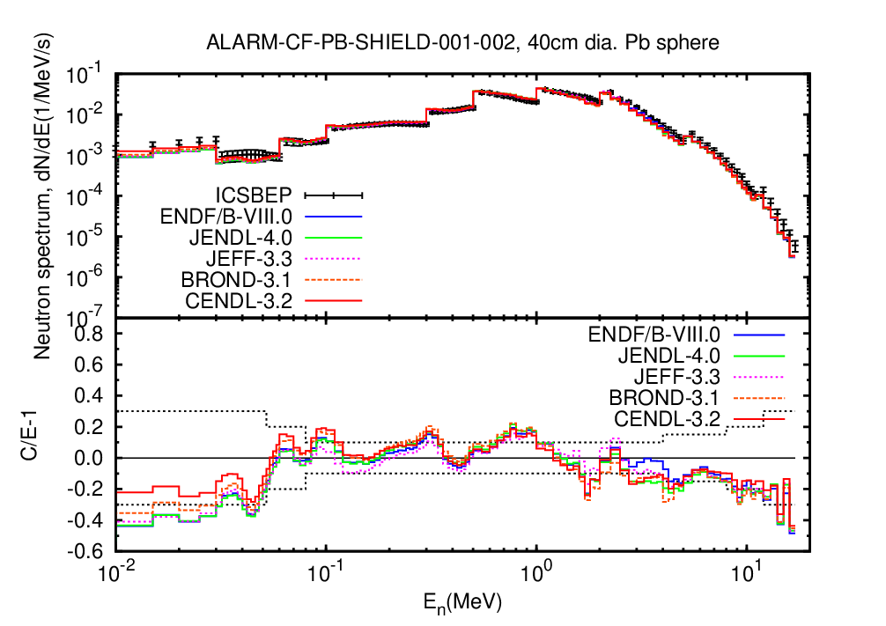
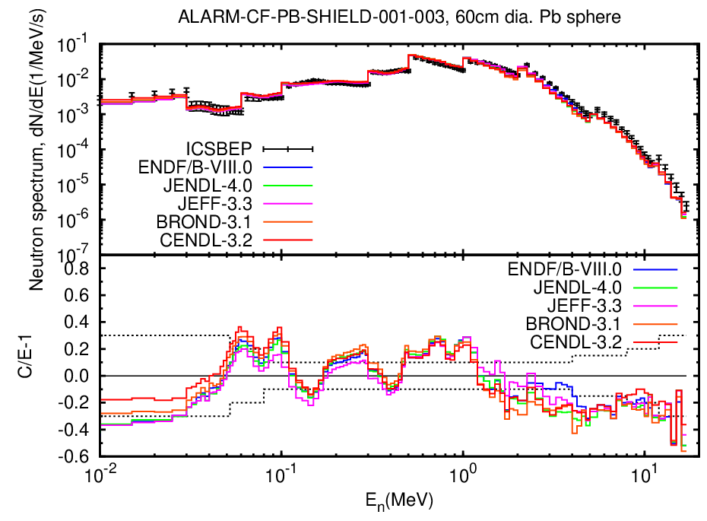
4. Result of the IPPE sphere
ENDF/B-VIII.0 gives the best results.
Both under estimation and over estimation were found.
<0.05MeV and >2MeV
0.05~0.1MeV and 0.5~1MeV
2mfp
4mfp
6mfp

Slide 8
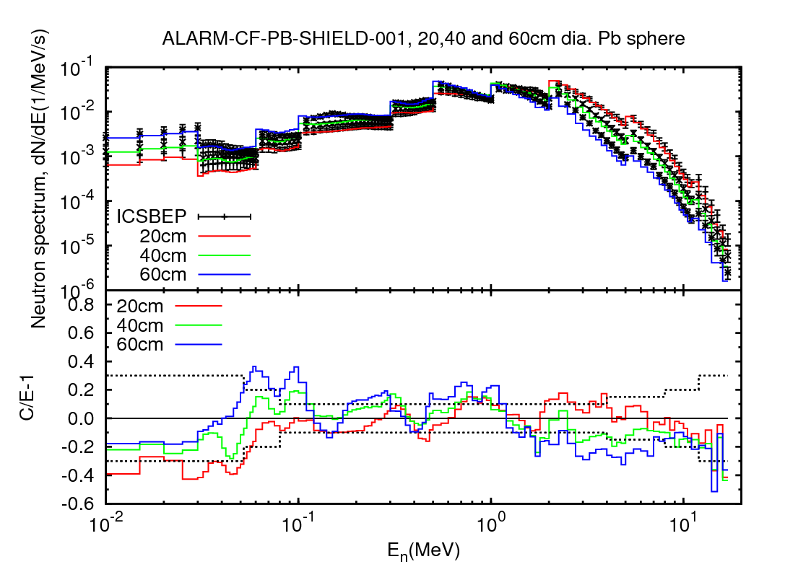
4. Result of the IPPE sphere
Bias related to thickness
1.2-8.4MeV, underestimation of neutron flux against thickness increasing were caused by overestimation of (n, inl) scattering.
Below 1MeV, overestimation of neutron flux were partially caused by overestimation of (n,inl) cross sections.
CENDL-3.2

Slide 9
5. Discussion and Summary
Pb evaluations from 5 major library were validated with shielding benchmarks, similar performance were shown in comparison.
The sensitivity of leakage neutron flux to macroscopic total cross section was deduced, which equals the number of MFP for the sample thickness.
Thicker sample, higher sensitivity.
When absorb reaction is weak, scattering reaction will play main role.
Validation results of FNS and the IPPE sphere show that
Above 1.2 MeV, (n,inl) cross sections were overestimated.
Around 0.366-0.494MeV, (n,el) cross sections were overestimated. Resonance parameters for lead need to be improved.

Slide 10
Thank you for your attention !
Questions?

